Slide 1




Astronomy 1010 chapter 16
Clayton State University
Slides for Astronomy textbook from OpenStax
https://openstax.org/books/astronomy/

Slide 2
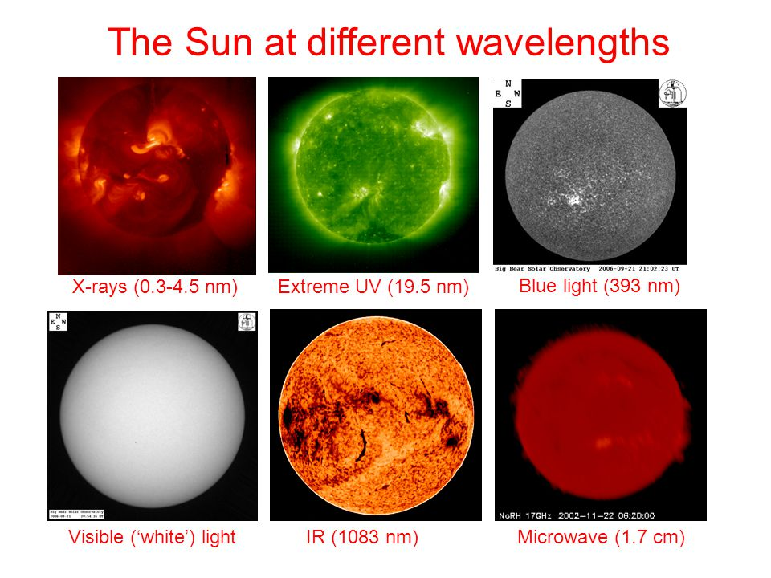
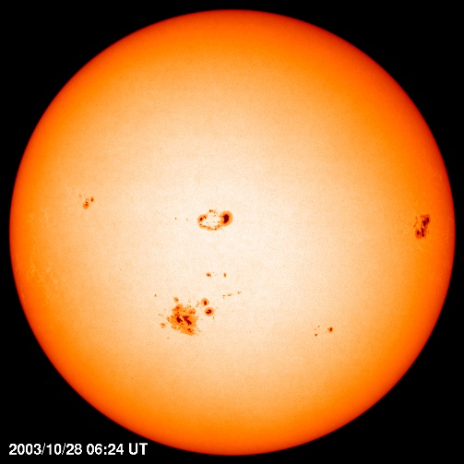
Sun in different wavelengths

Slide 3
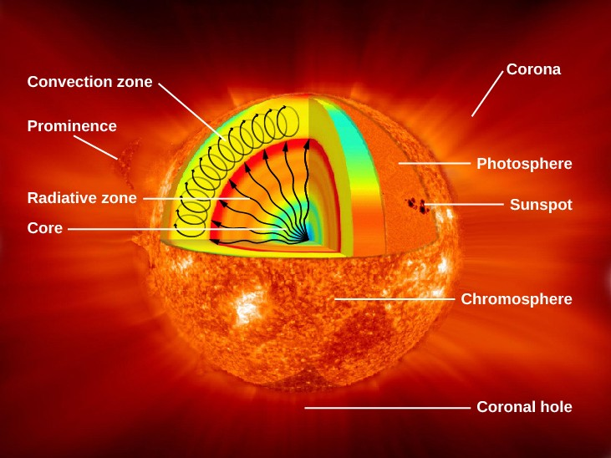
Recall: The structure of the Sun

Slide 4
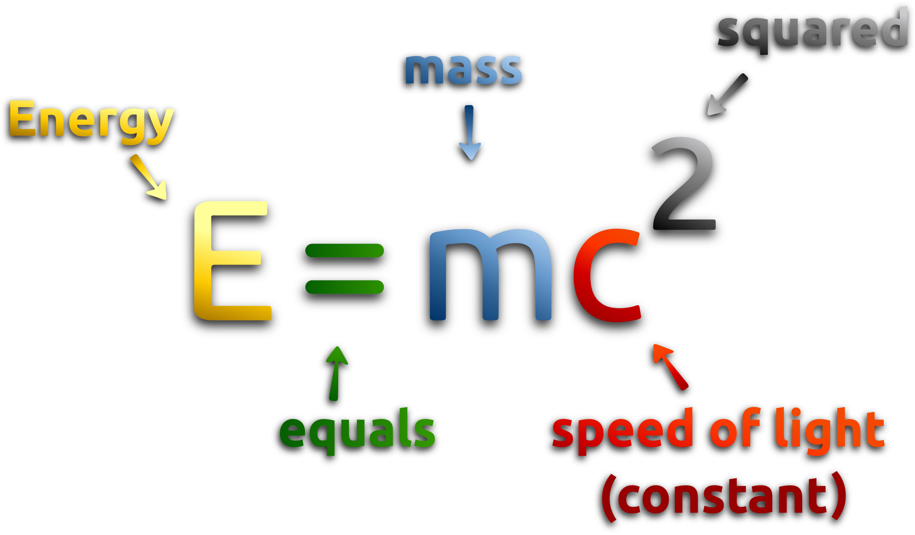
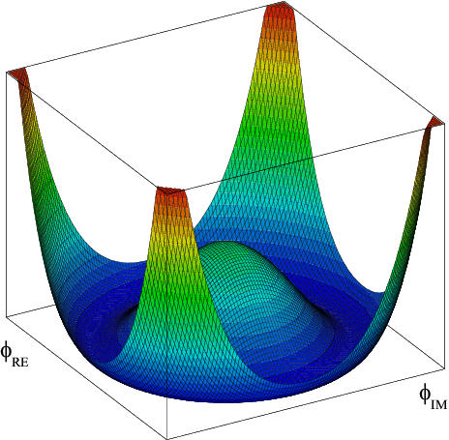
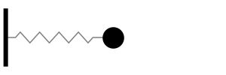
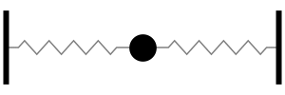
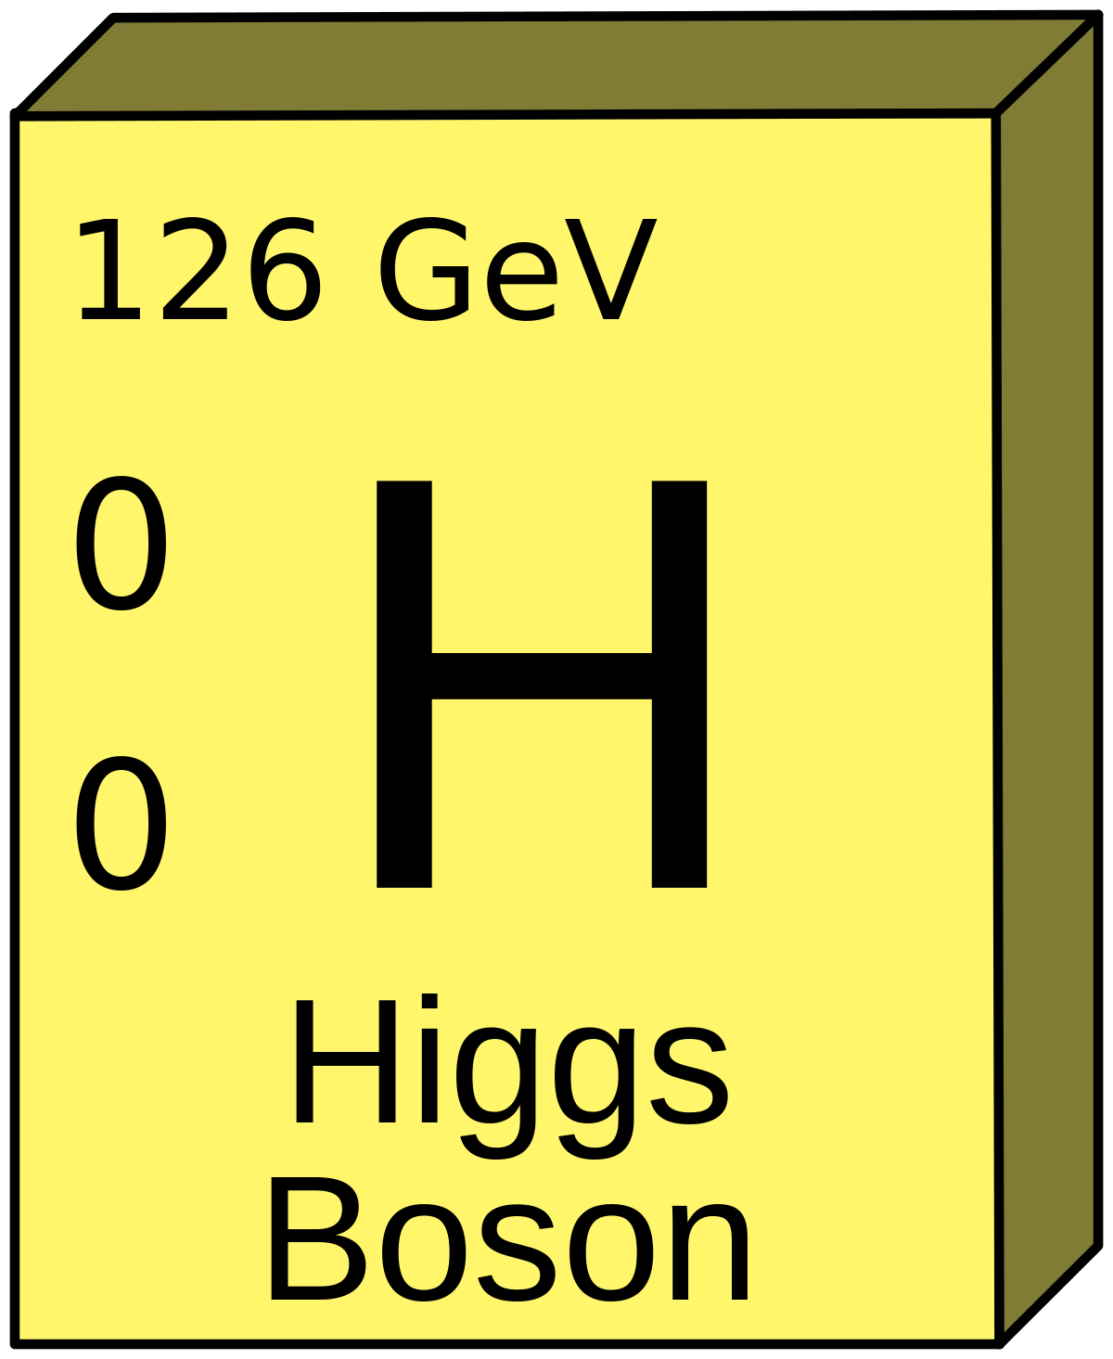
What power the Sun?
Chemical burning?
Gravitational collapse?
Anything else?
First, we need to learn about so-called rest mass
What makes the mass bounce?
Think it’s gravity?
What if its not a mass at all? (very, very light)
What else can it be?
This is how Higgs mechanism creates rest mass (inertial).

Slide 5
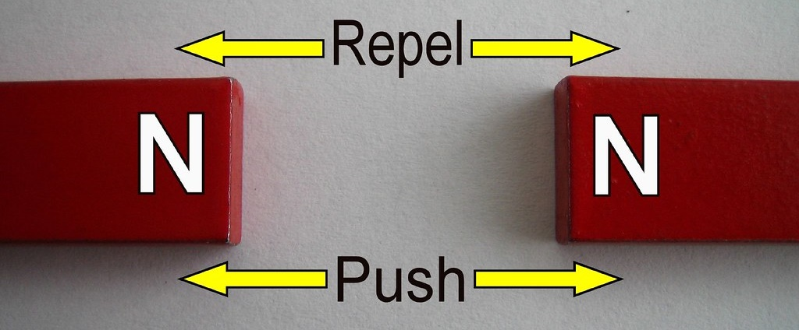
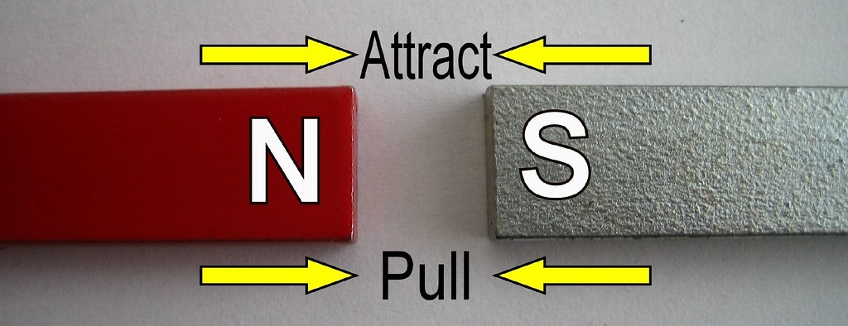
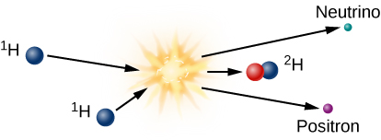
Binding Energy
Same poles of the magnet repel – give energy to join
Opposite poles attract – energy is released
  Excess is released (as heat in this case)
  If what to separate back, need to give energy into system
If two protons come very close, they want to attract via ‘strong force’ but electric charge repels
One proton can become neutron (i.e. neutral)
The rest mass of proton + neutron is less that that of proton and neutron separately
Energy is released

Slide 6
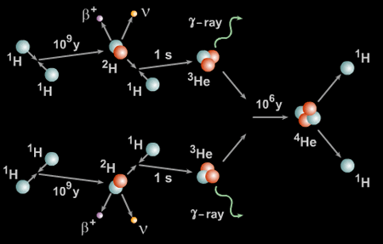
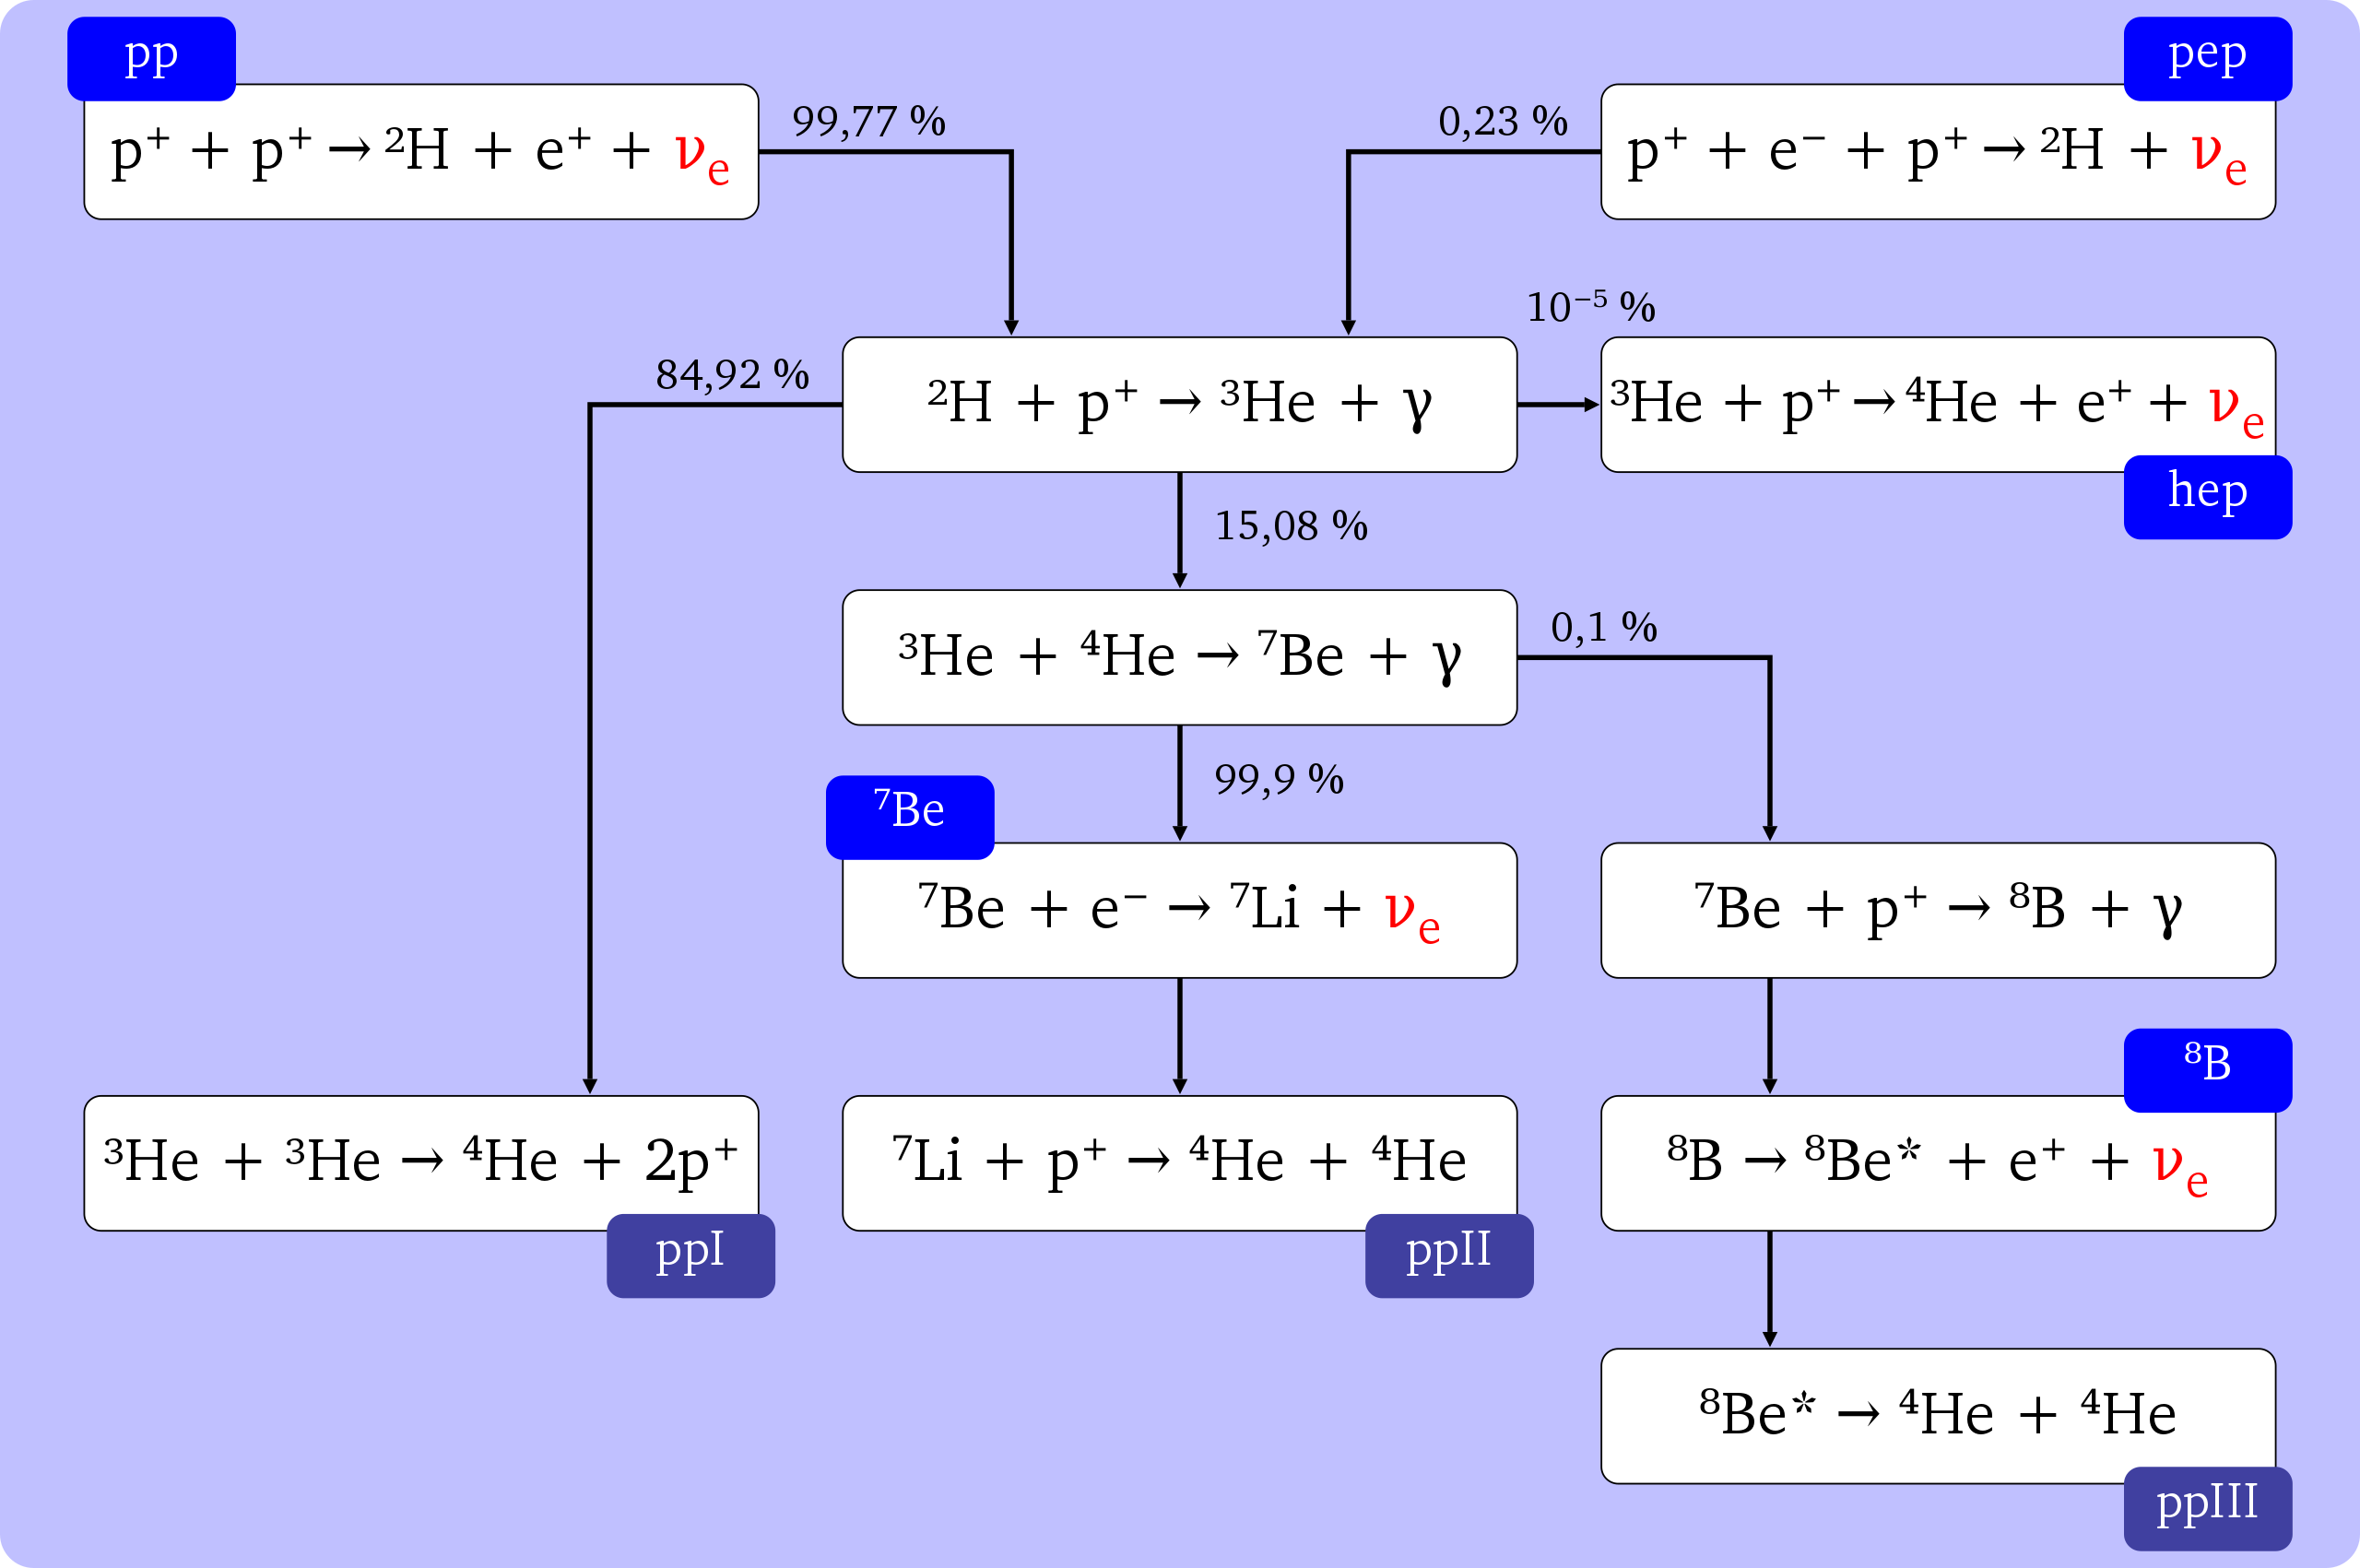

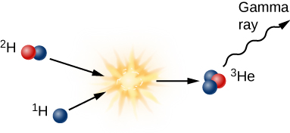

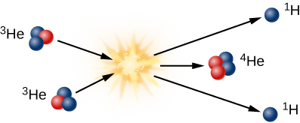
pp-cycle (ppI)
All ‘adult’ stars produce energy by burning 4 protons into 1 helium nucleus
http://astronomyonline.org/Stars/Evolution.asp
Videos from http://www.windows2universe.org/sun/Solar_interior/Nuclear_Reactions/Fusion/Fusion_in_stars/H_fusion.html

Slide 7
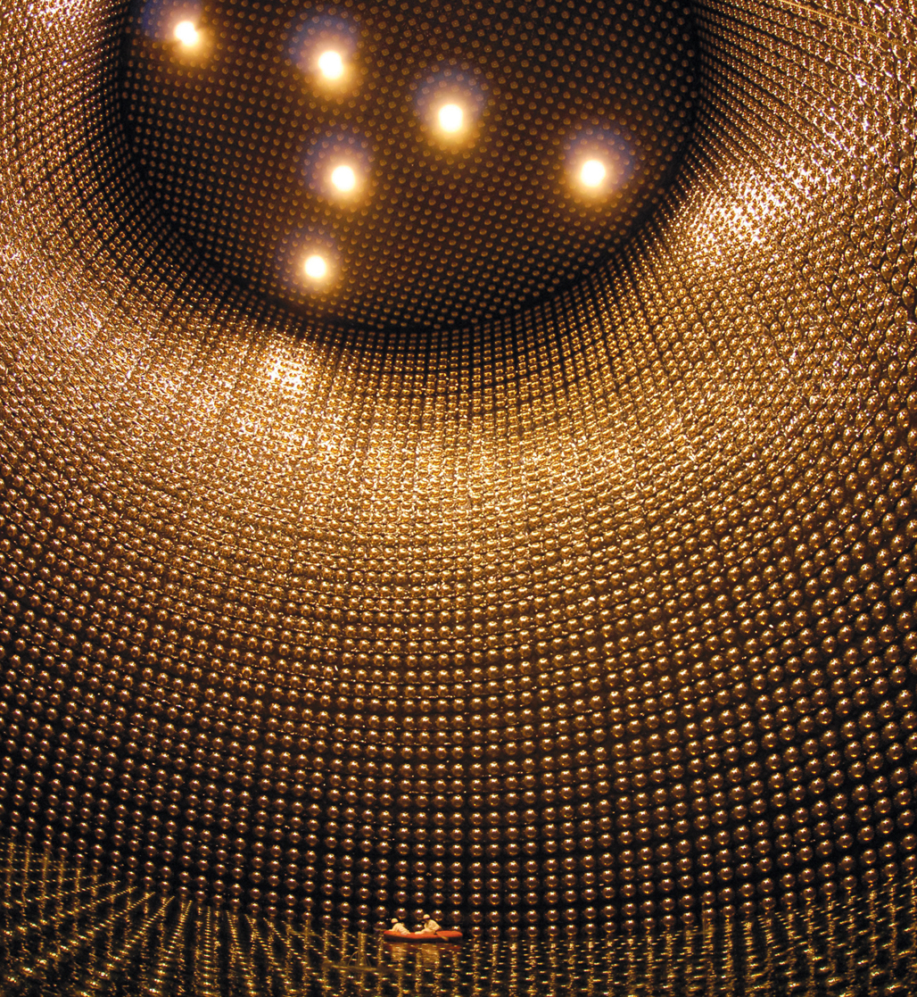
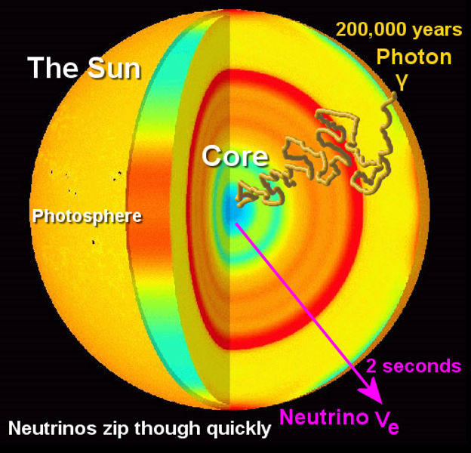
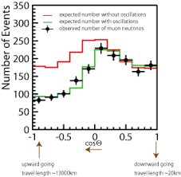
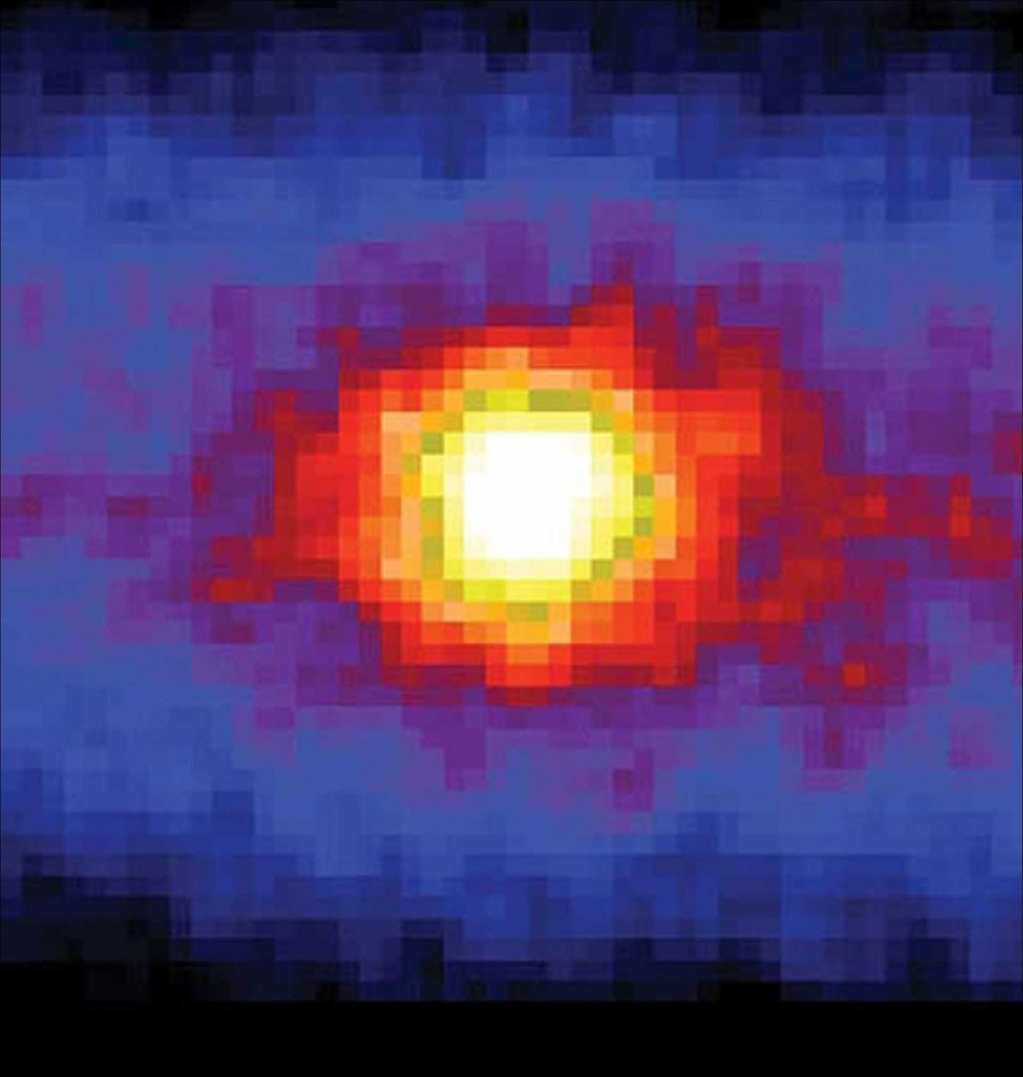
Solar Neutrinos
Neutrinos change ‘flavor’ during their travel from the Sun center.
Image of the Sun at night!
https://newhumanist.org.uk/articles/2402/the-sun-at-night

Slide 8
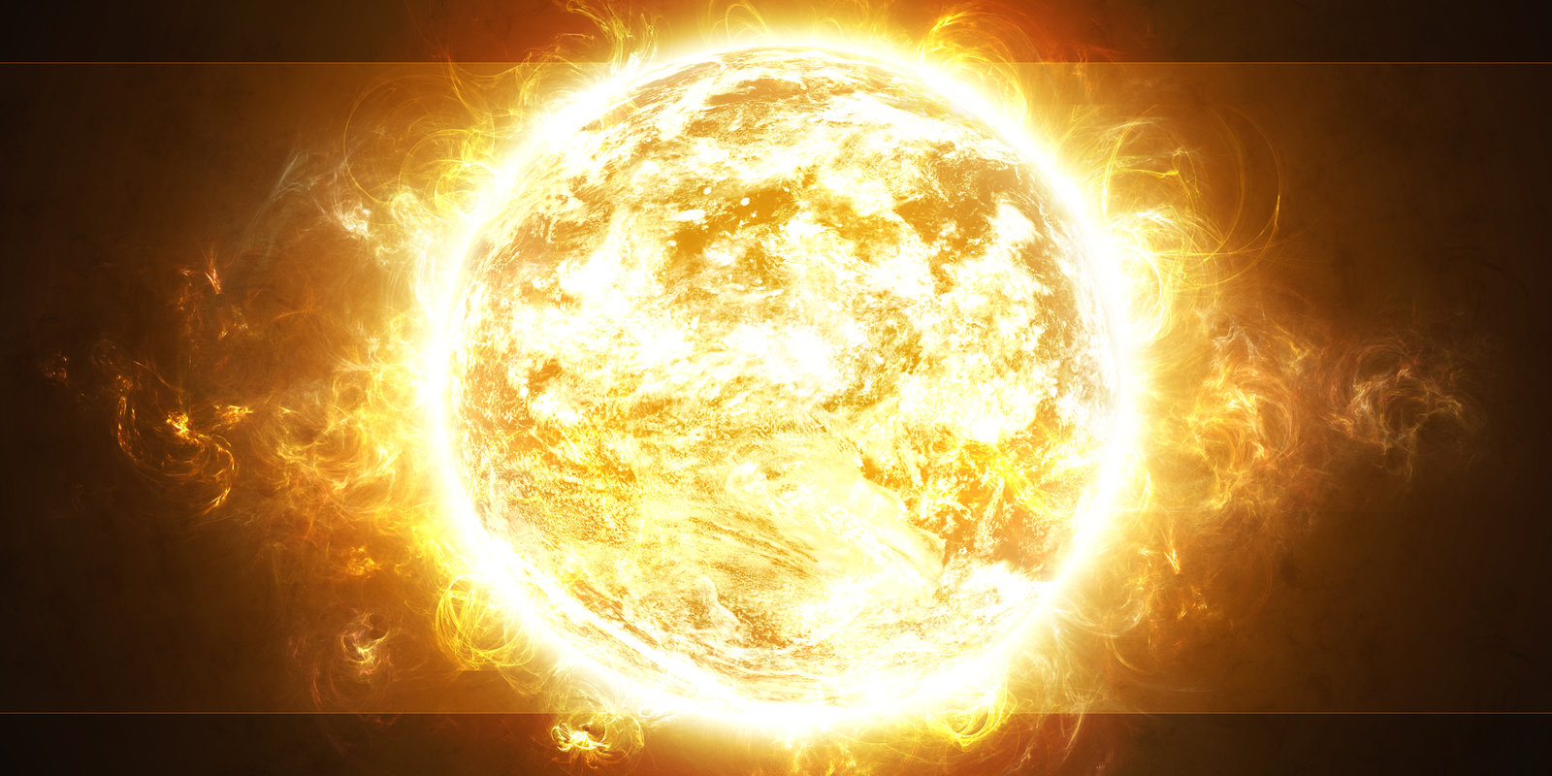

Any questions?
What makes out Sun different from most of the other stars?

Slide 9
